Slide 1
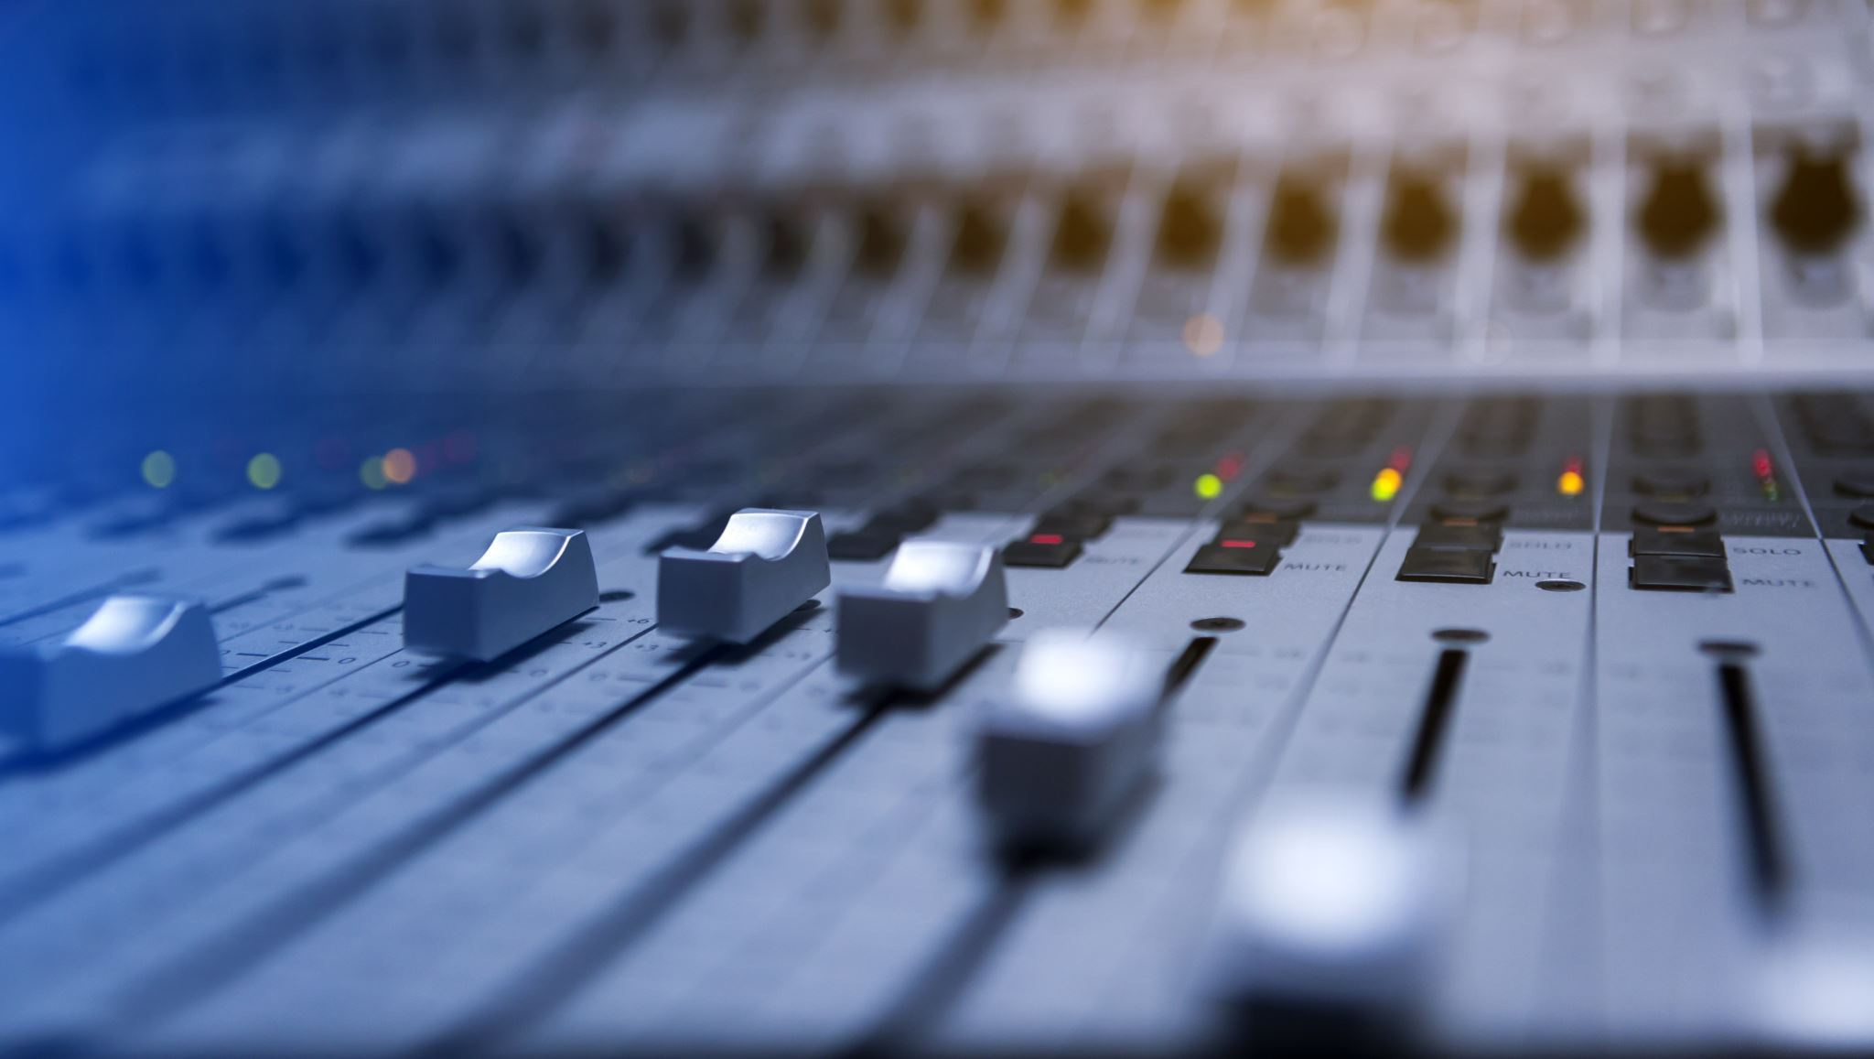
Multimodal IVR System: Enhancing User Experience with Realistic Voice & GUI Interaction
A research study on the effectiveness of multimodal INTERACTIVE VOICE RESPONSE in streamlining customer interactions.
F21CA
Multi-Modal IVR (The Best Team)

Slide 2

Introduction
A Multimodal IVR System that enables both voice and GUI interactions.
Uses Speech-to-Text (ASR), Dialogue Management (DM), and Text-to-Speech (TTS).
Research Goal:
To determine if multimodal features accelerate task completion in IVR systems.
To improve user experience and reducing frustration by making interactions faster.

Slide 3
Presentation Outline
Problems With Traditional IVRs
How Multimodal IVR Enhances the Experience
System Components
Evaluation Plan
Conclusion & Future Works
Traditional IVR model representation
Data Sources
Research Focus - Questions

Slide 4
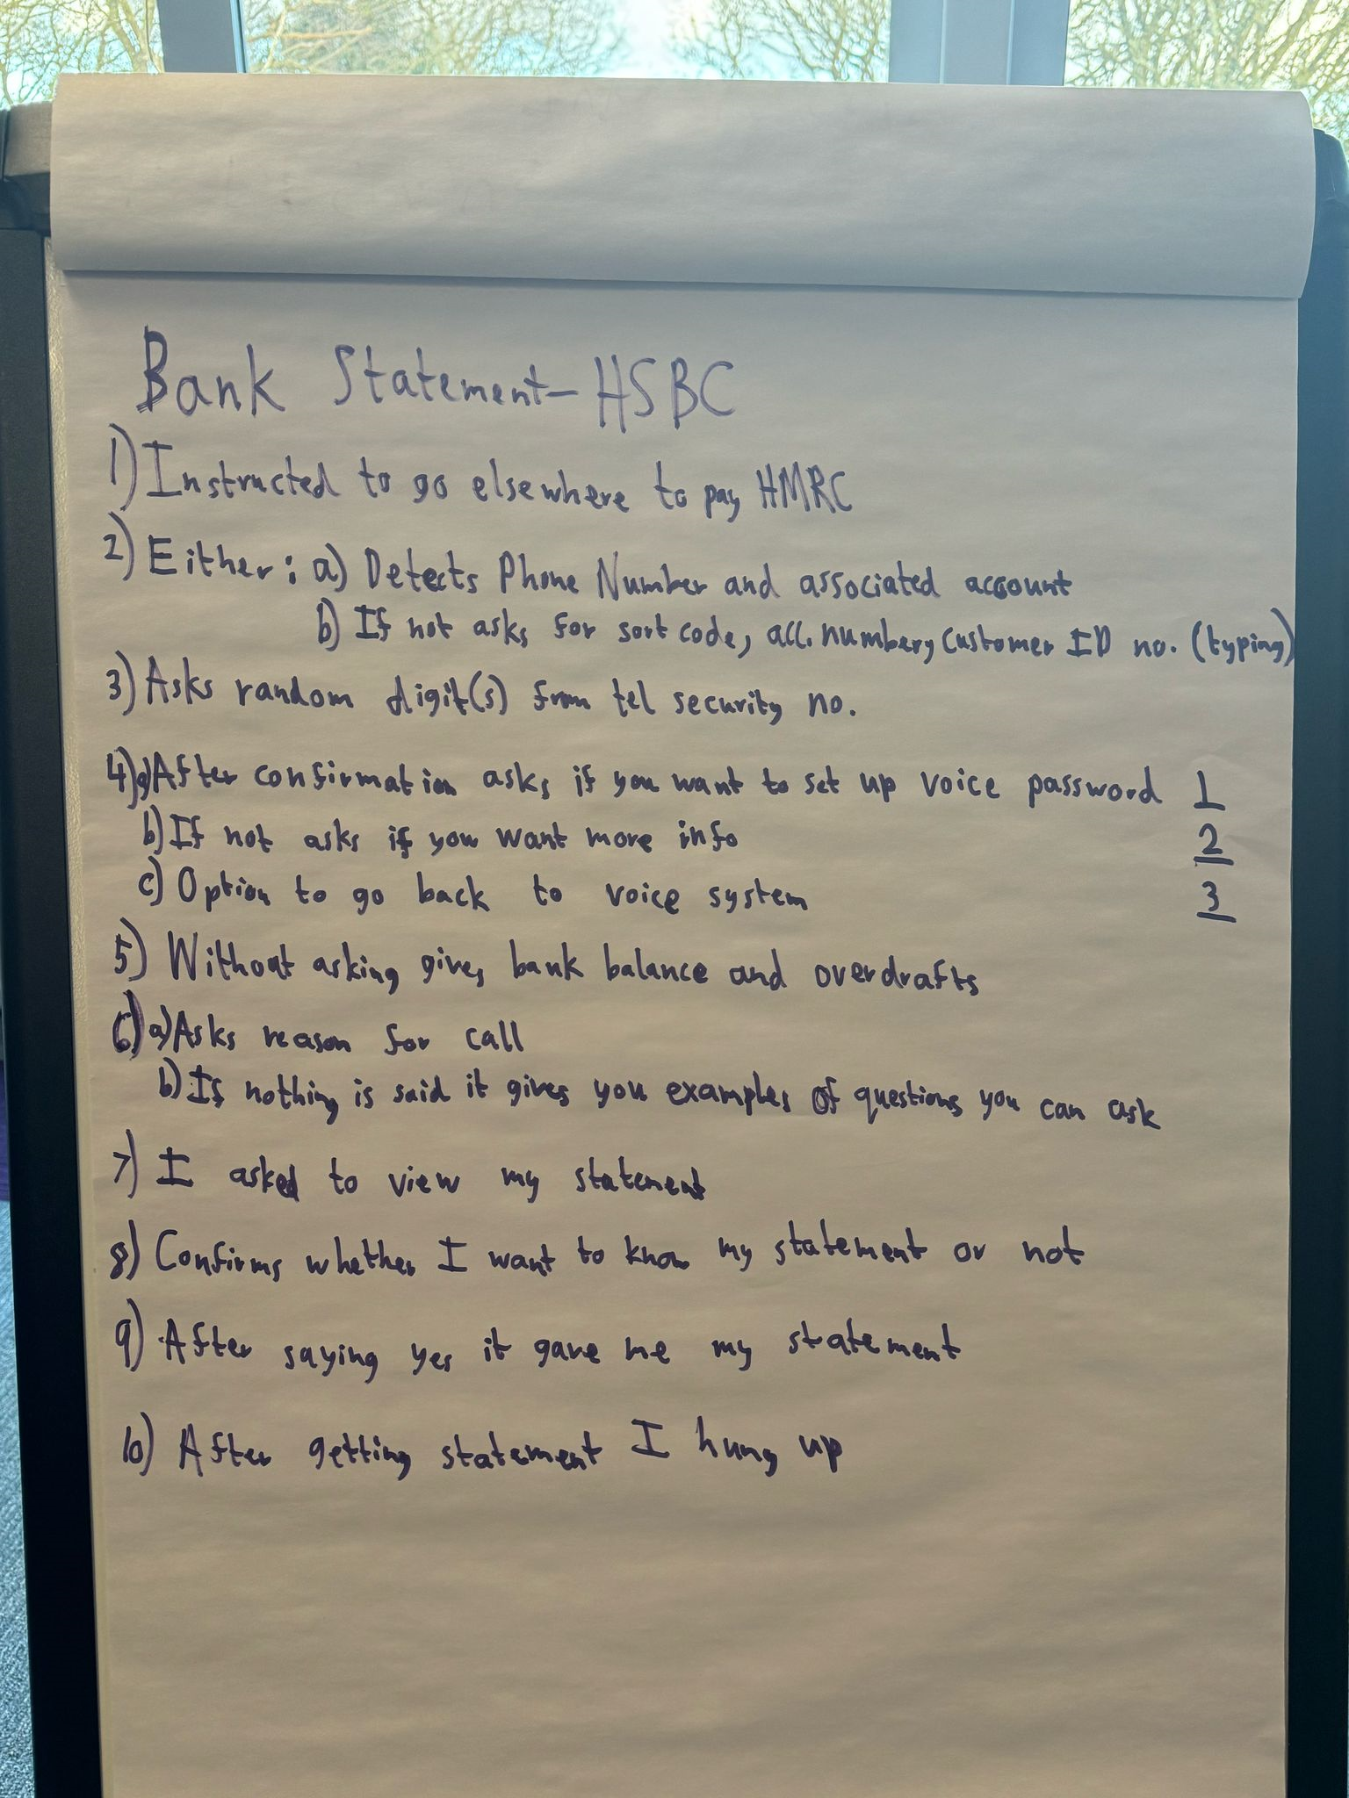
Problems With Traditional IVR
Long Questions
Excessive Waiting Time
Example: HSBC

Slide 5
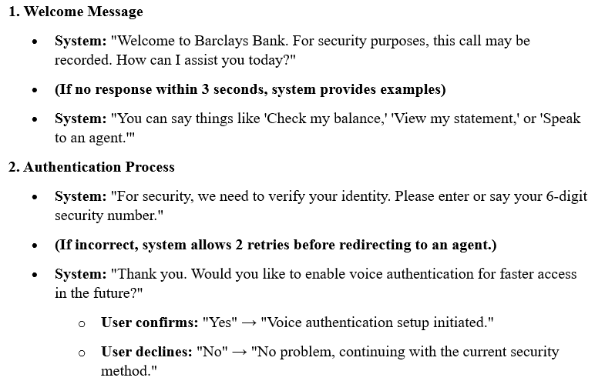
Current Findings (Barclays Bank)

Slide 6
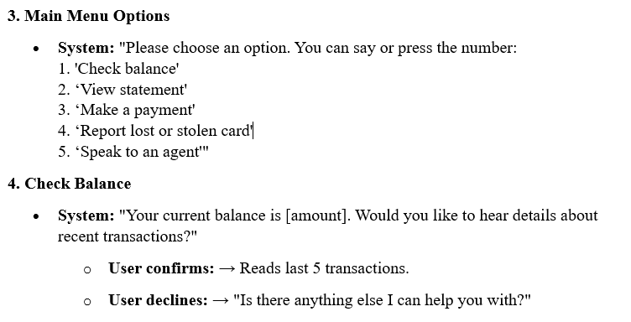

Slide 7
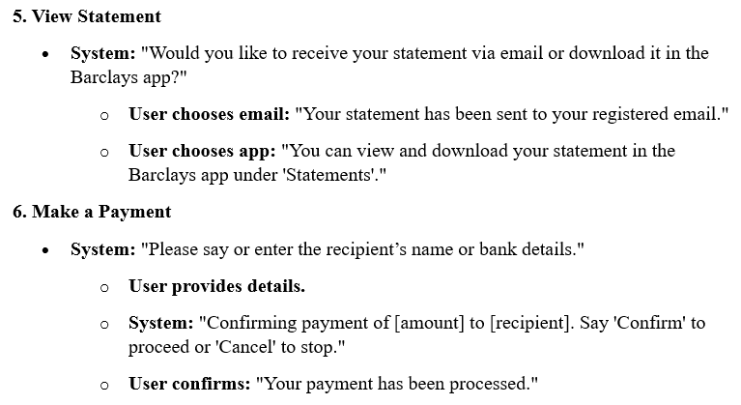

Slide 8
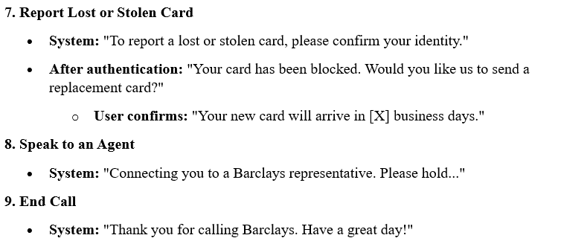

Slide 9
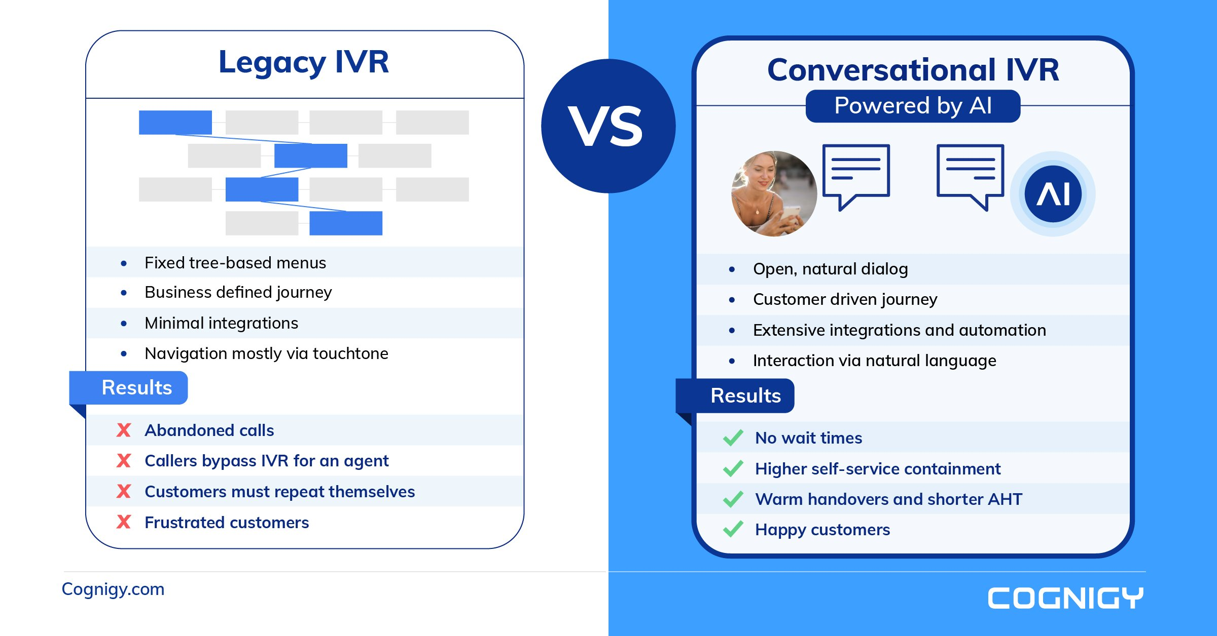

Slide 10
Research Focus - Questions
Spoken Language Understanding (SLU) – Can the IVR accurately recognize and interpret user intent?
Dialogue Management (LLM) – Can it handle follow-up queries and maintain context?
Natural Language Generation (NLG) – Does it generate clear, natural responses?
Multimodal Interaction – Does combining voice + GUI improve user experience and efficiency?

Slide 11
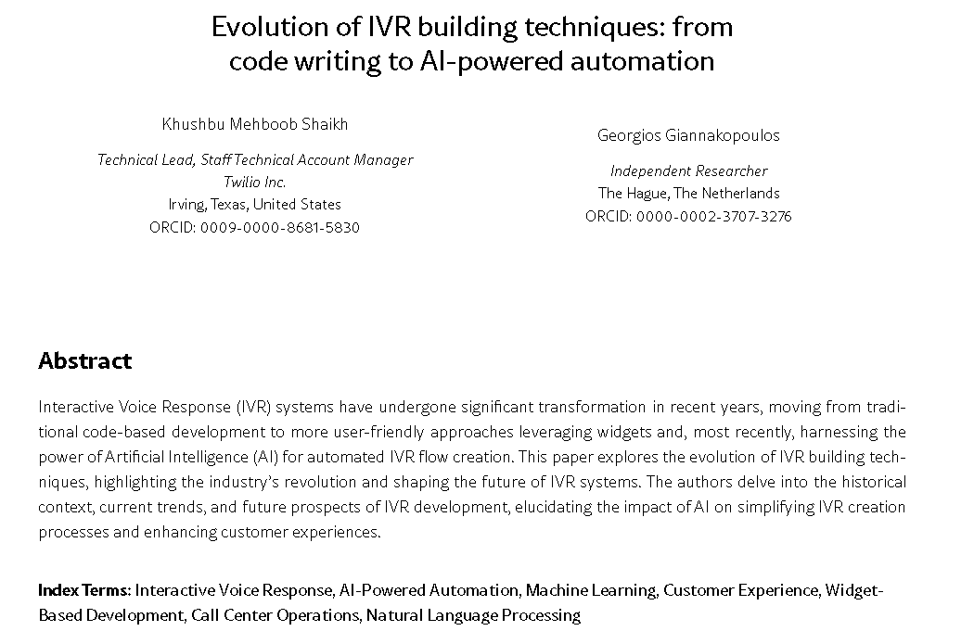

Slide 12
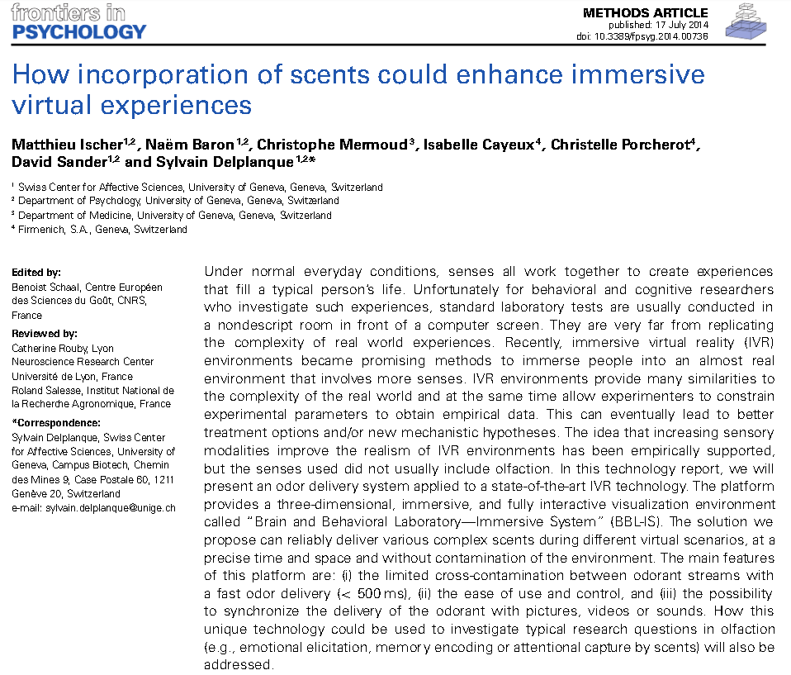

Slide 13
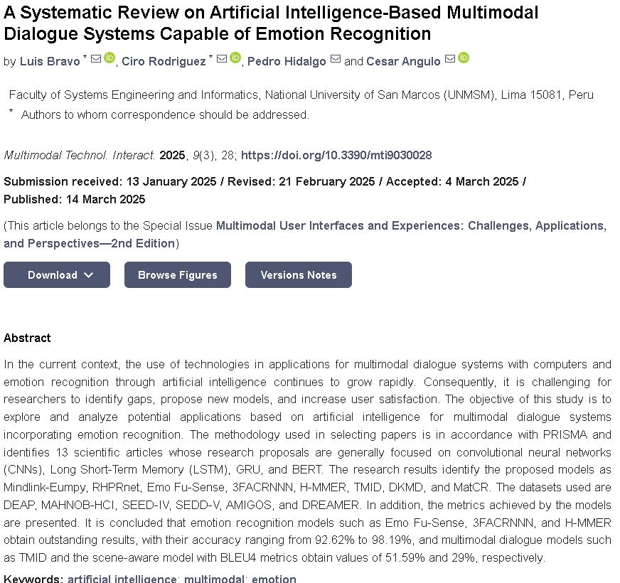

Slide 14
System Components
Components | Tool / Libraries
Speech-To-Text (ASR) | Azure/ Wav2Vec2
Text-To-Speech (TTS) | Azure TTS/ Suno Bark
LLM (Dialogue Management) | Deepscaler (Ollama)
GUI | Tkinter (desktop)
Backend Processing | Python, Flask (API)
Table 1: The components and their corresponding tools/libraries.

Slide 15
Datasets
All Data is produced internally.
Excel Sheet with random dummy data.
Will convert to JSON file later.
No external resources are used.

Slide 16
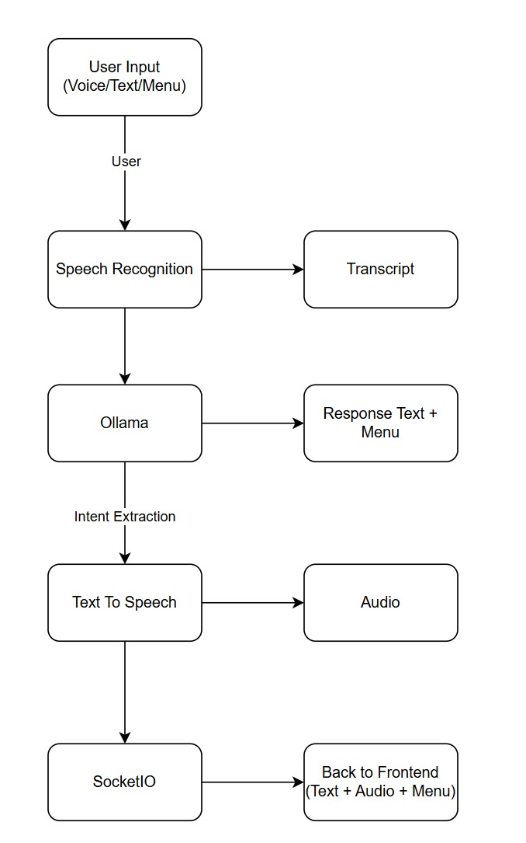
Workflow

Slide 17
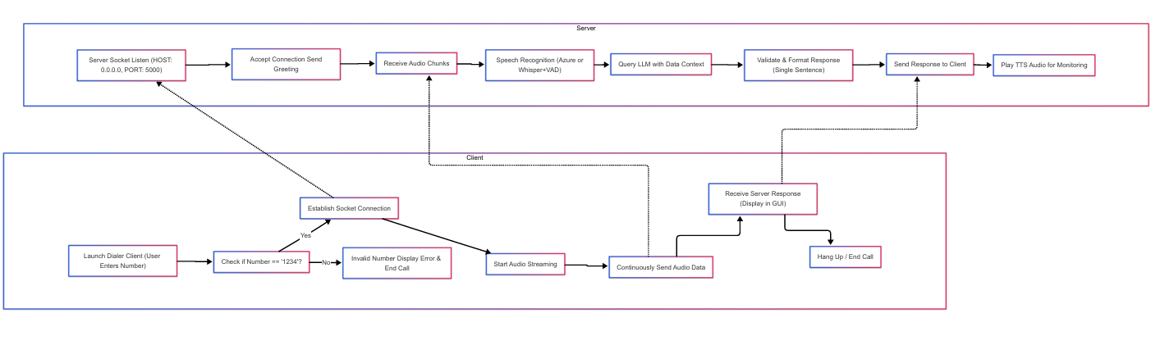
Work Flow Until Now

Slide 18
Evaluation Plan –1
Metric | Description
Word Error Rate (WER) | Measures the accuracy of ASR transcription
Response time | Time taken for IVR to process and reply
Task Completion Rate | Percentage of successful interactions
User Satisfaction | Feedback ratings from test participants
Table 2: The evaluation methods used for the system..

Slide 19
Evaluation Plan –2
User Testing
Measure task completion time, response time, track errors, and collect user feedback
Compare traditional IVR vs. multimodal IVR experience
Internal Testing
Developers test interactions to assess IVR response accuracy
Debug and refine ASR, DM, and GUI interactions

Slide 20
Conclusion & Future Works
Multimodal IVR improves user experience by integrating voice & GUI interactions.
AI-driven enhancements (ASR, LLM(DM), TTS) provide faster, smarter responses.
User testing & evaluation metrics confirm efficiency improvements.
Internal data collection ensures controlled evaluation & privacy.

Slide 21
Conclusion & Future Works
An IVR model with...
Faster response.
More accurate TTS.
More realistic experience.
Versatility.
Different frameworks for the system...
Azure
Twilio API/ Other similar APIs

Slide 22
Thank You

Slide 23
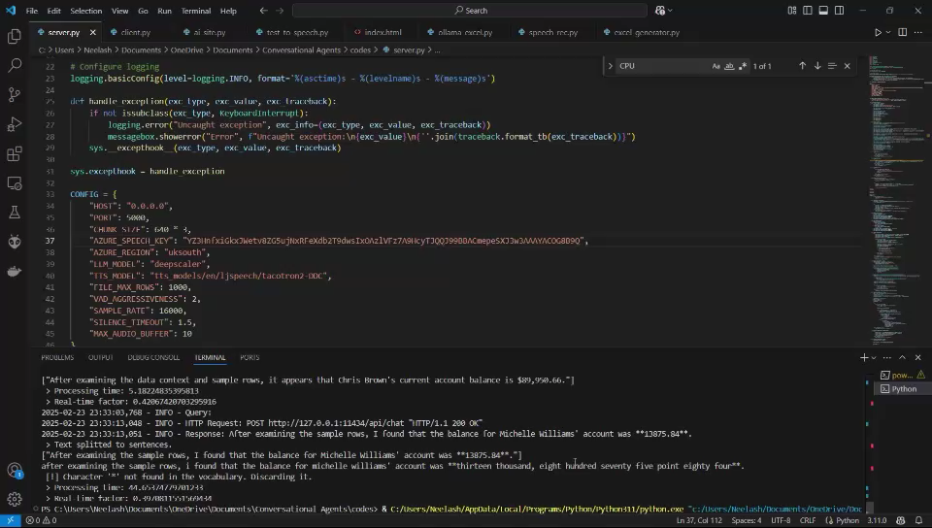

Slide 24
